Slide 1

Introduction to ggplot2
12/12/2022
Magdalena Drożdż
Try now:
Open Rstudio
Run “library(tidyverse)“
Tell me about any errors
Go to: bit.ly/magda_ggplot

Slide 2
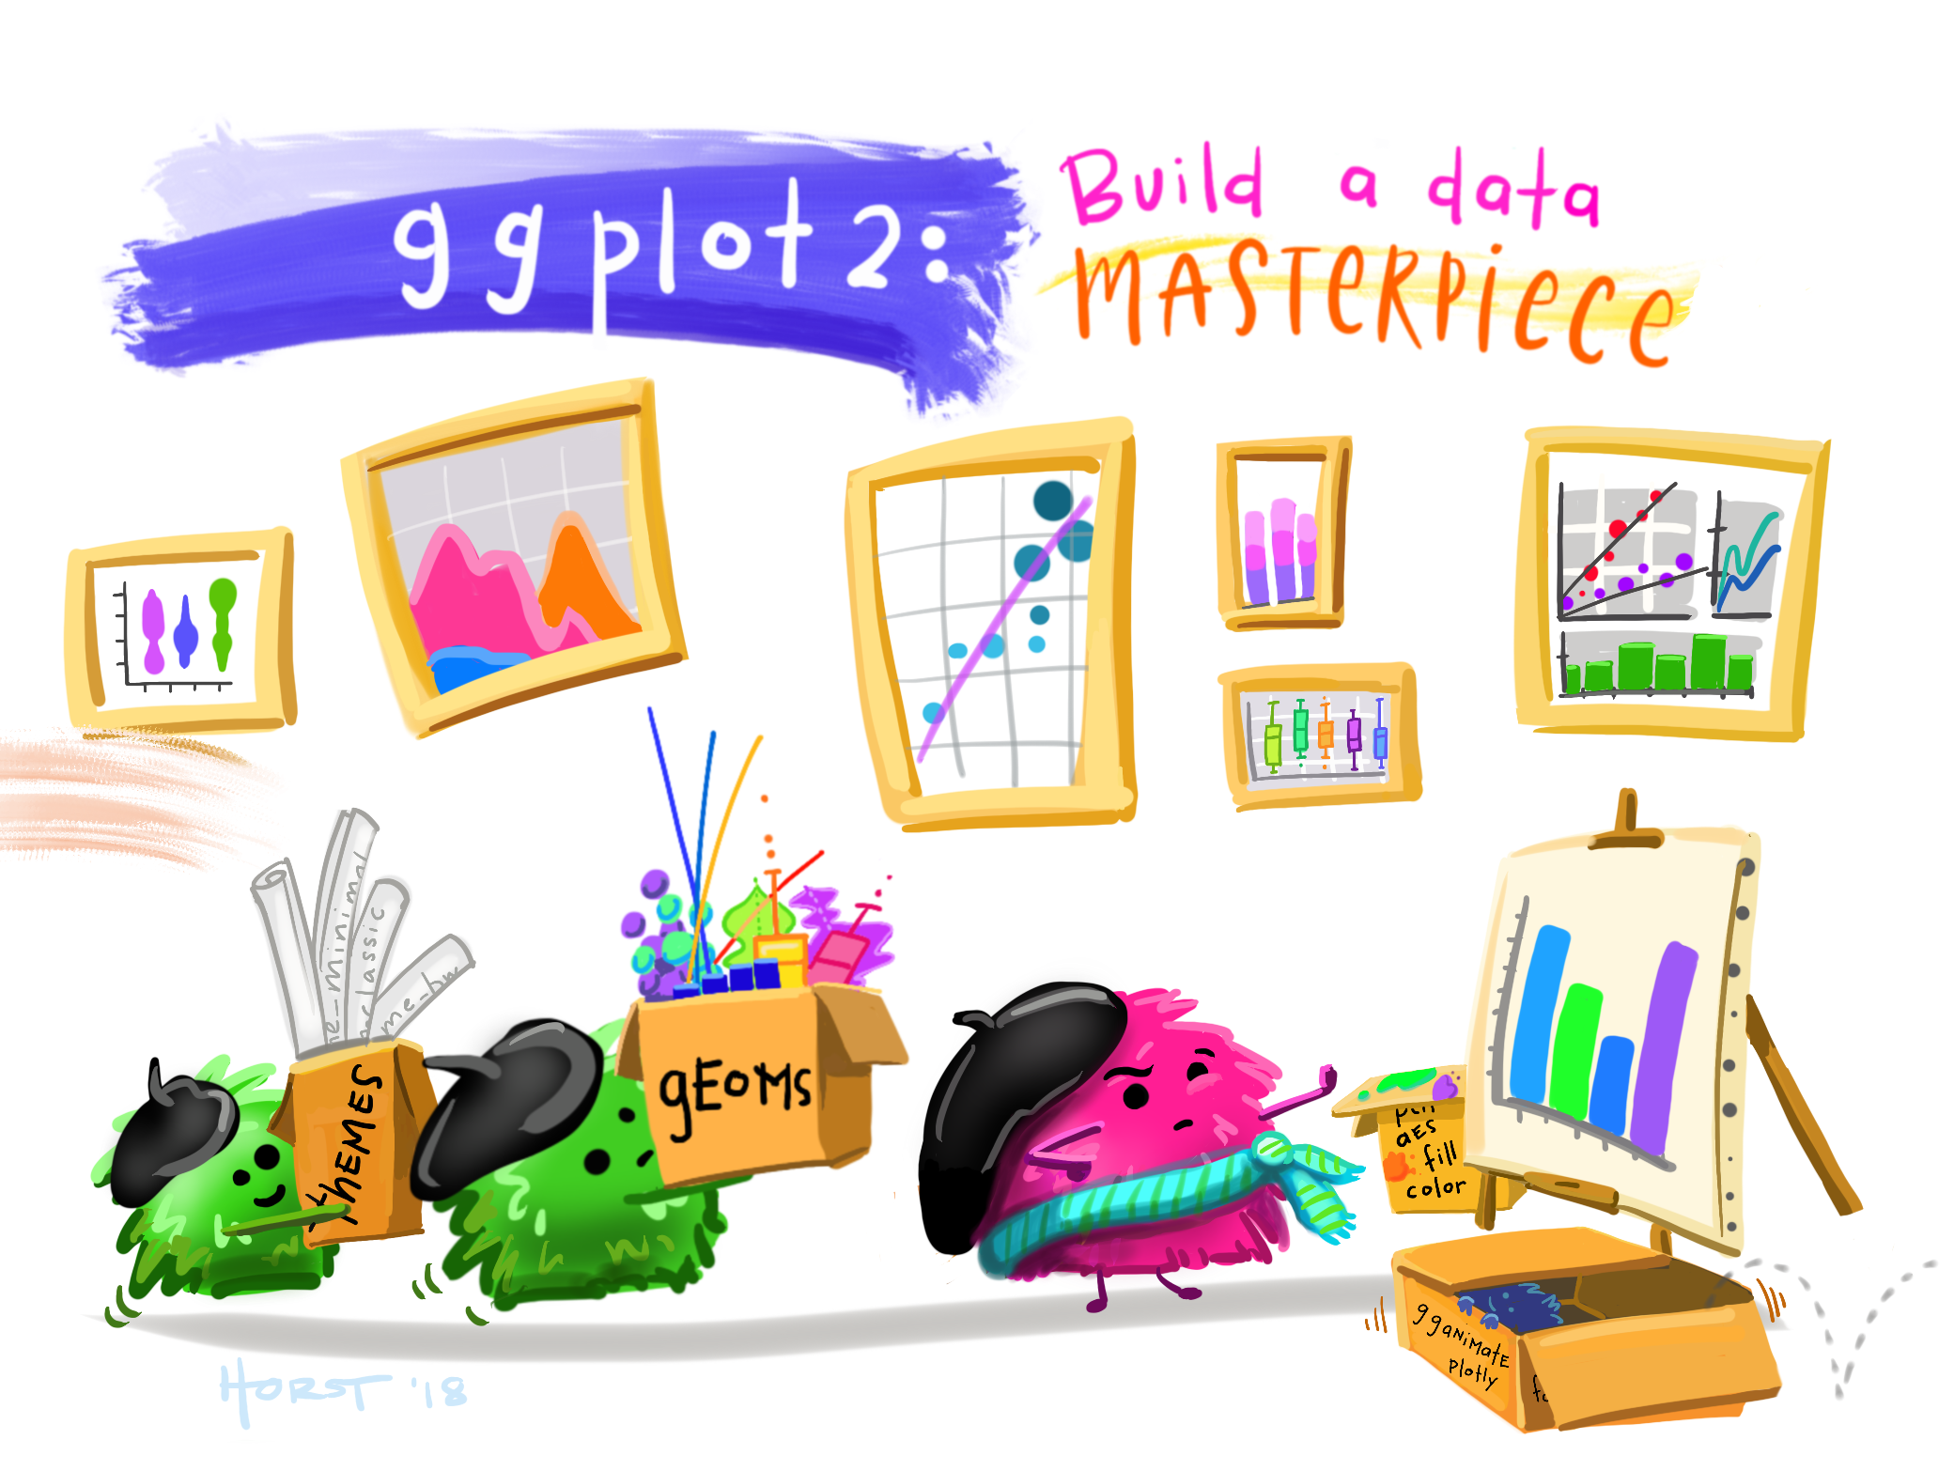
Workshop plan
Introduction & what is ggplot2?
Plotting the first graphs
Troubleshooting and tips!
Artwork by @allison_horst

Slide 3
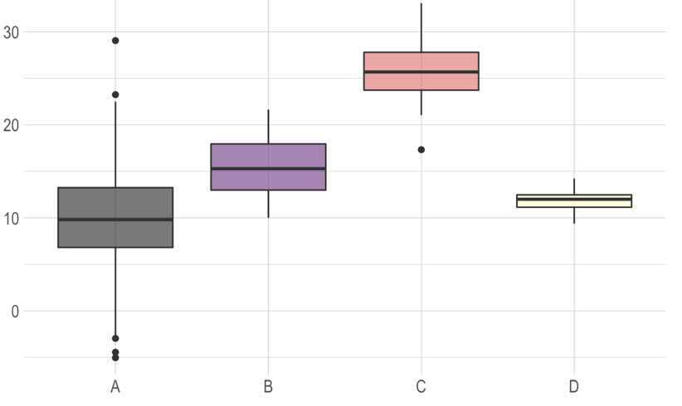
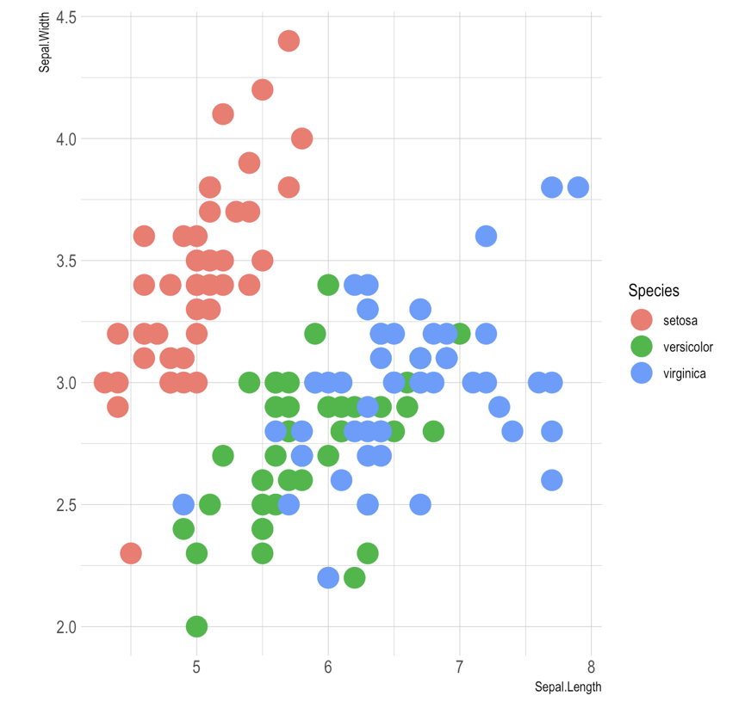
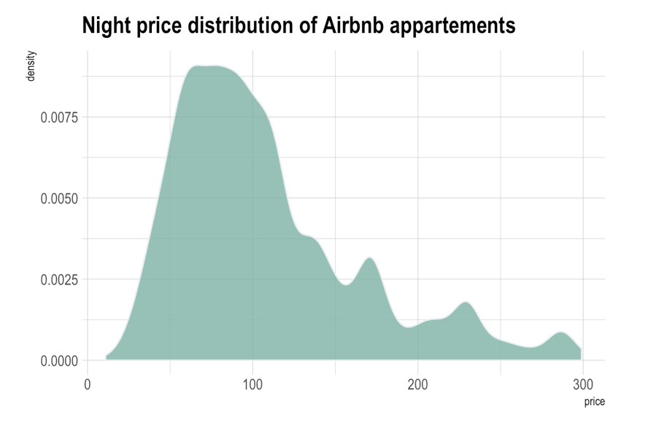
What is ggplot2?
An R package used to create plots based on the grammar of graphics.
source: https://www.r-graph-gallery.com

Slide 4
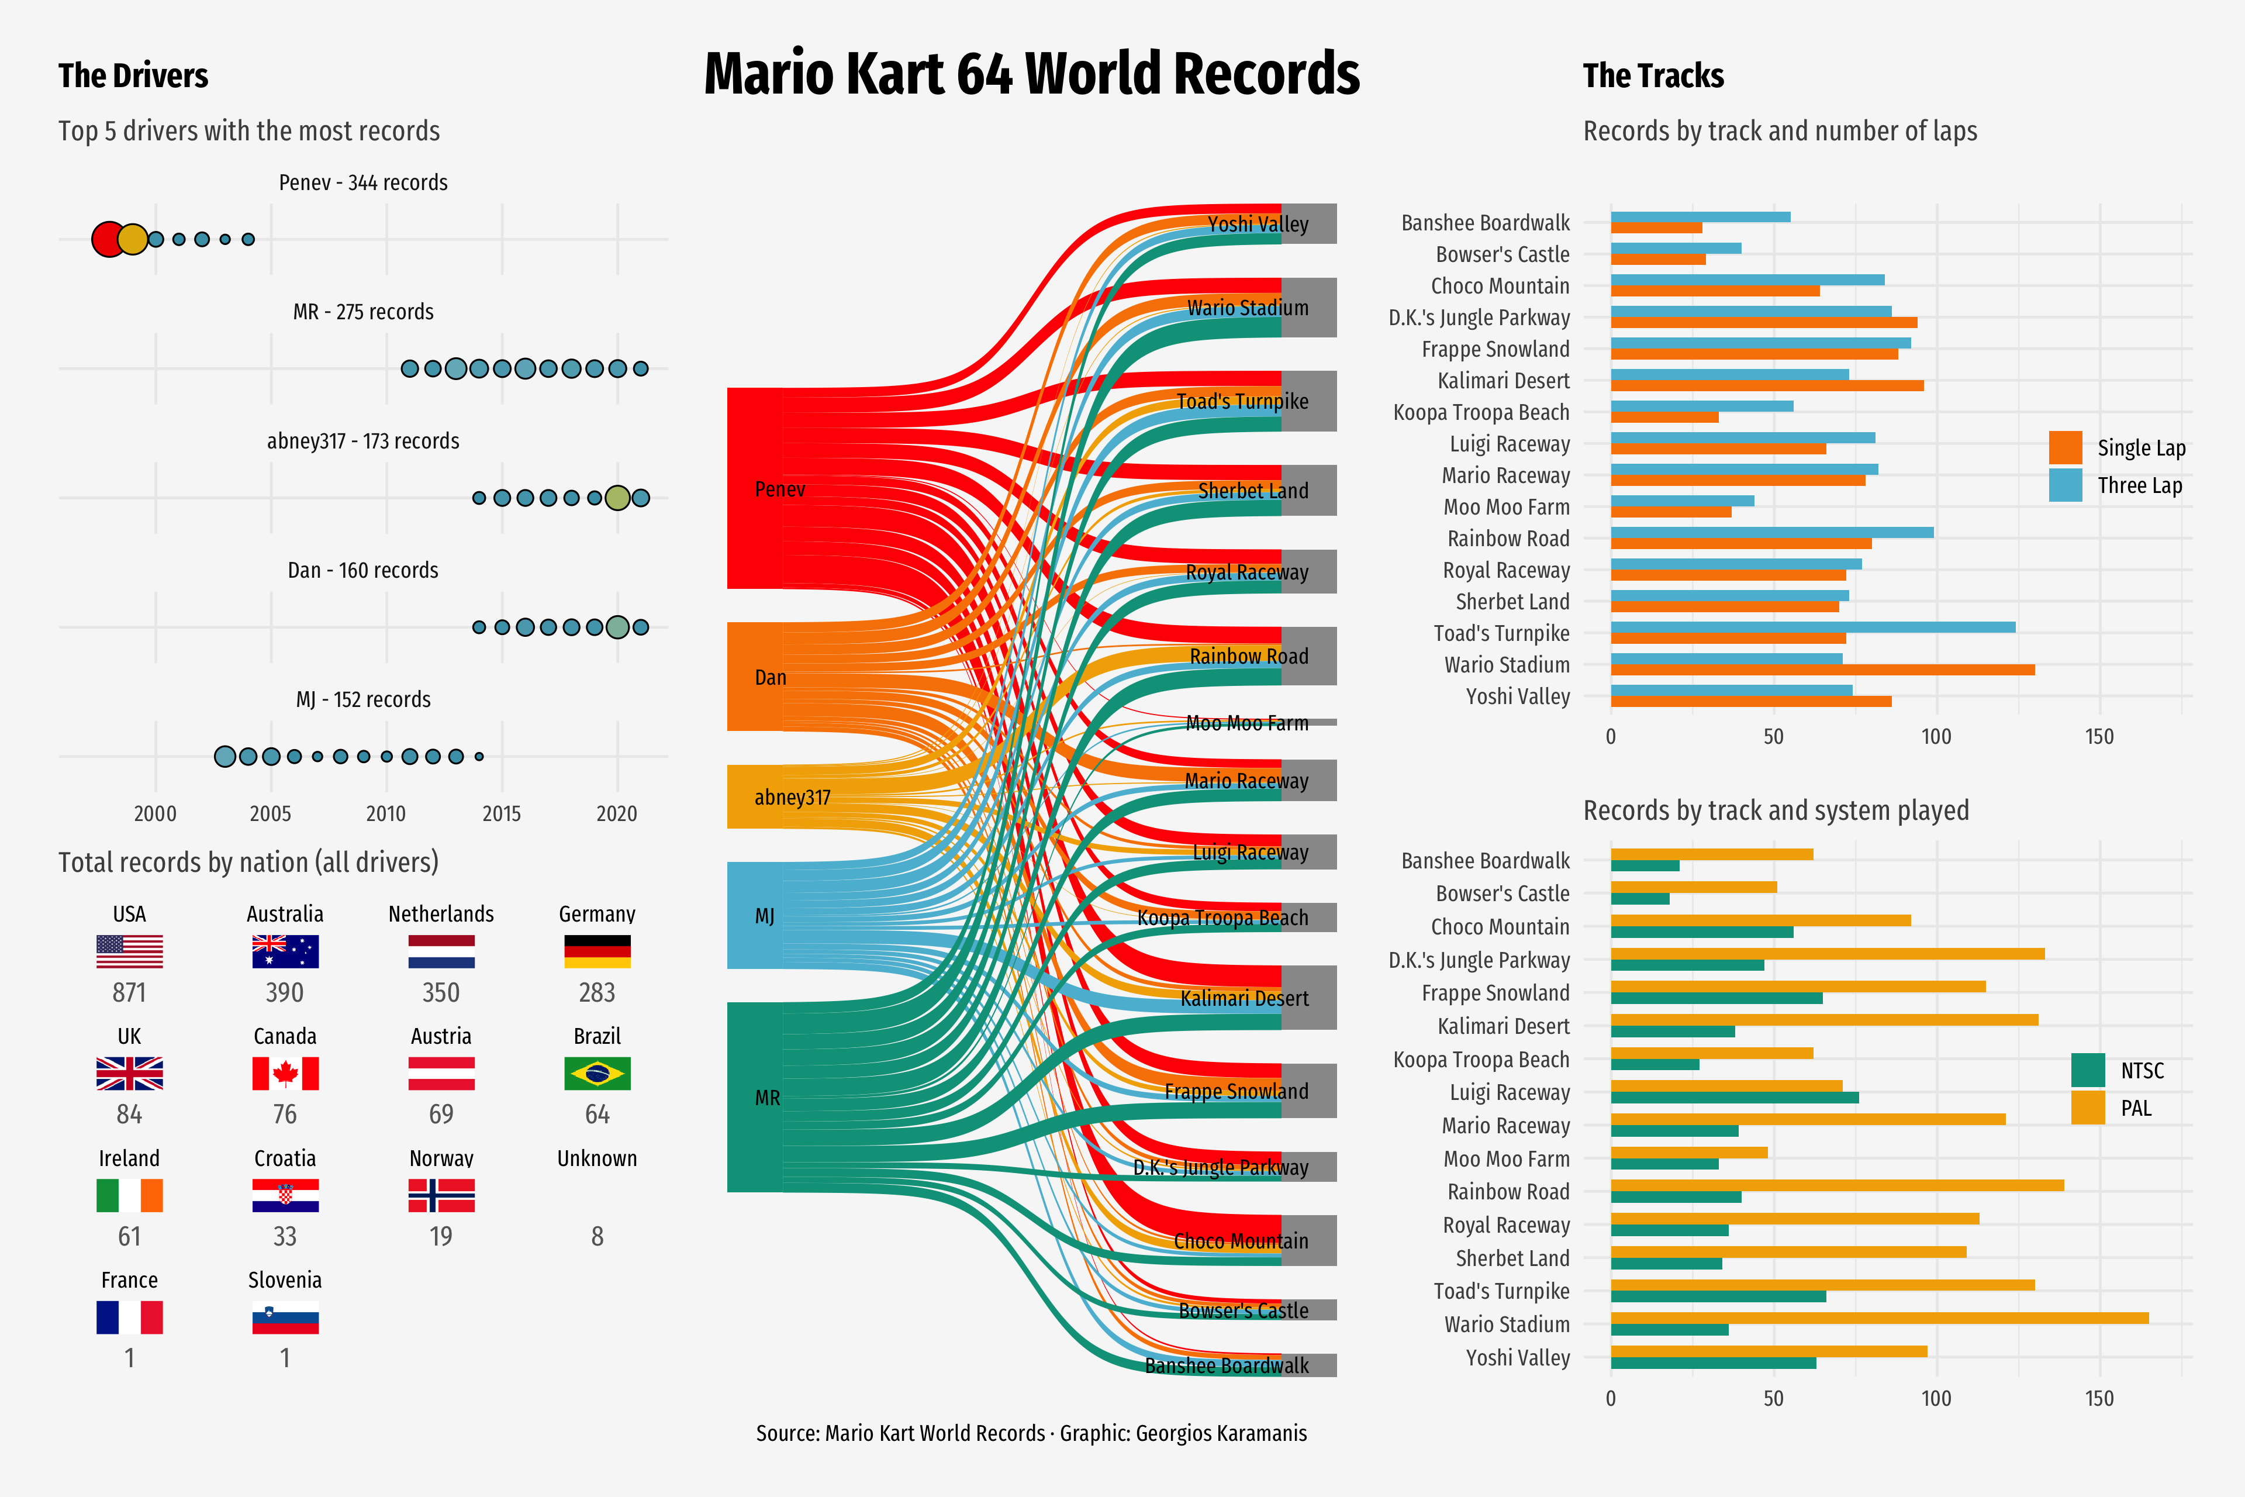
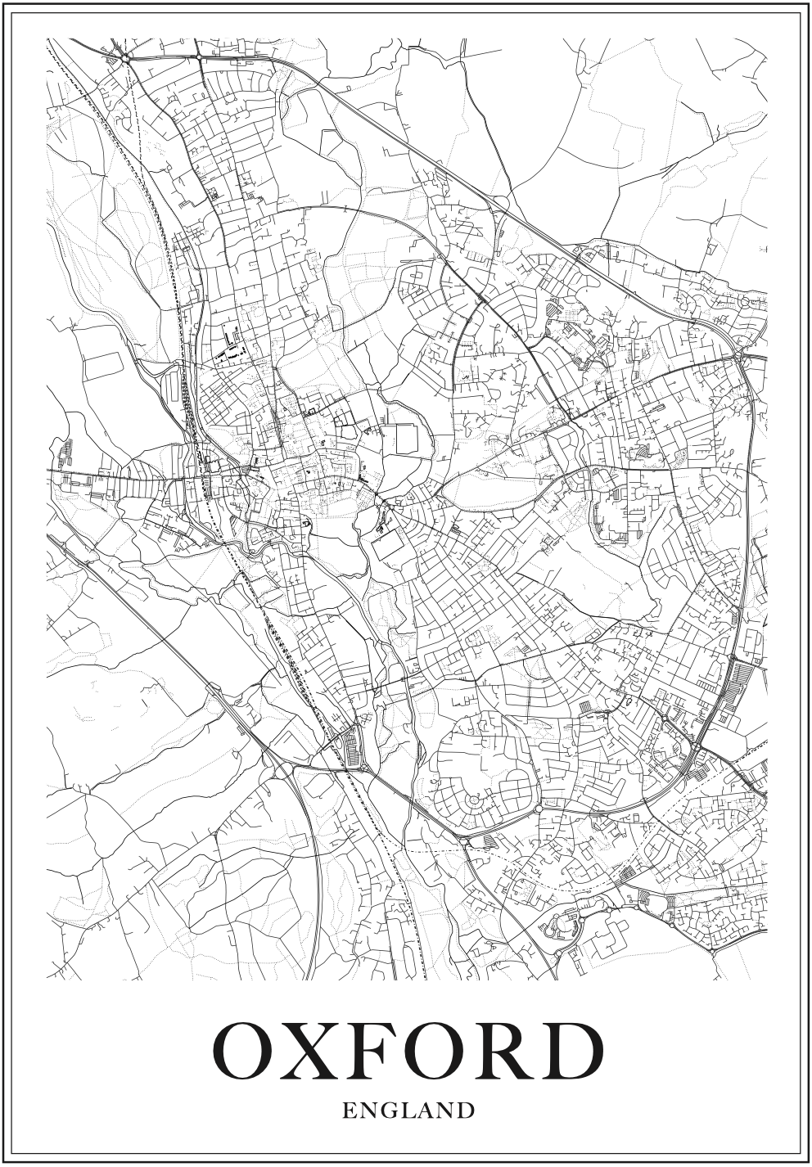
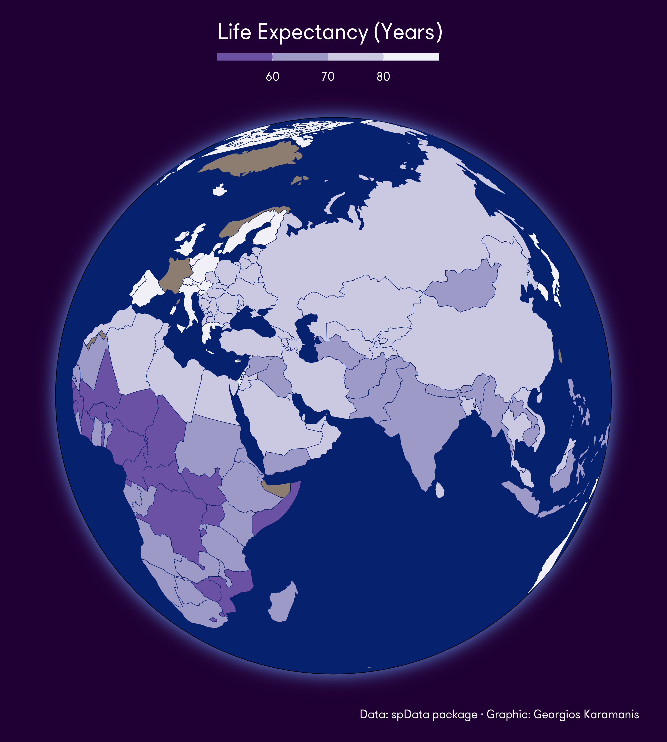
What is ggplot2?
An R package used to create plots based on the grammar of graphics.
1st and 3rd graph by Georgios Karamanis

Slide 5
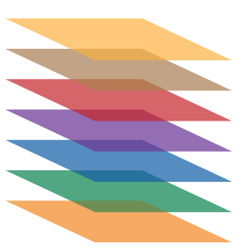
The Grammar of Graphics
A framework consisting of layered approach to visualize the data. In case of ggplot2 the components usually are:
Data – our datasets
Aesthetics – what do we want on the axes? Do we want to encode by colour/shape?
Scale – do the values need to be scaled?
Geometric objects (geoms) – points, bars, lines, or maybe a map?
Statistics
Facets – do we need subplots?
Coordinate system

Slide 6
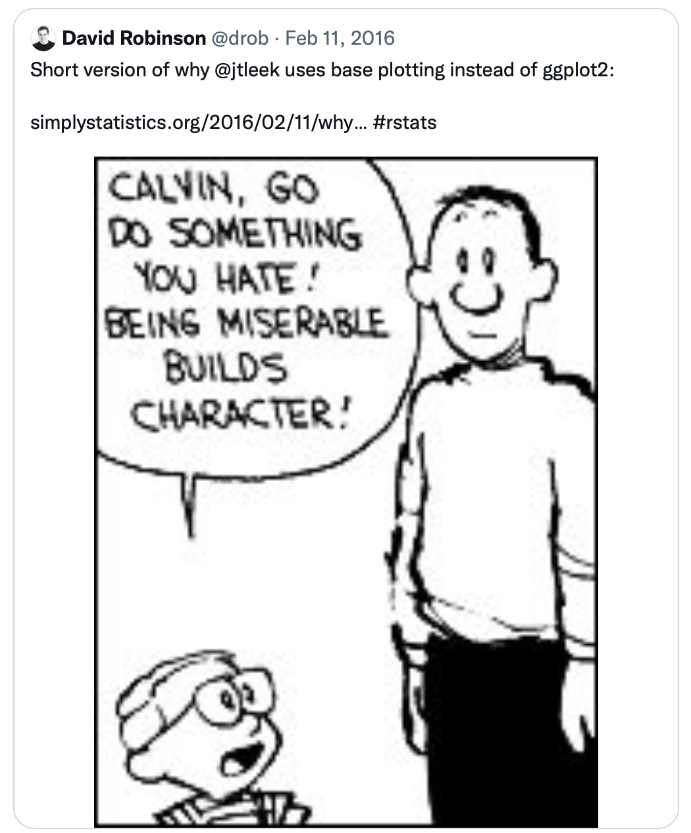
Why not base R?
much easier to make the plots pretty
even defaults are more aesthetic
more understandable syntax (…once you get used to it)
easy faceting
Sometimes it’s still a controversial topic ☺

Slide 7
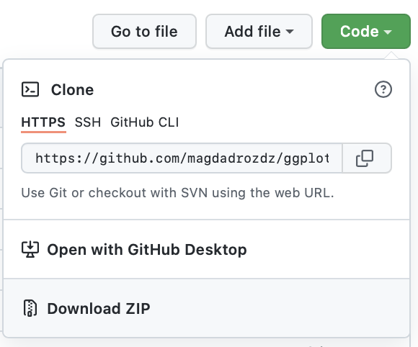
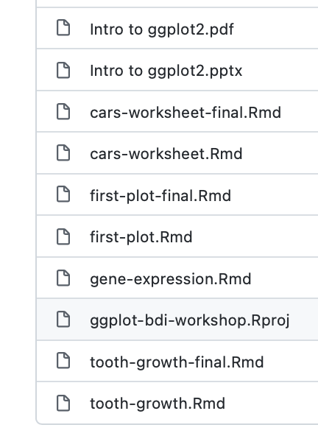
Download Github code
bit.ly/magda_ggplot

Slide 8
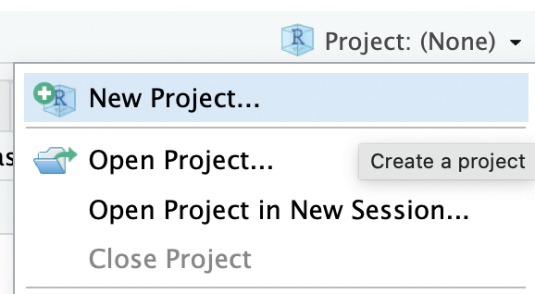
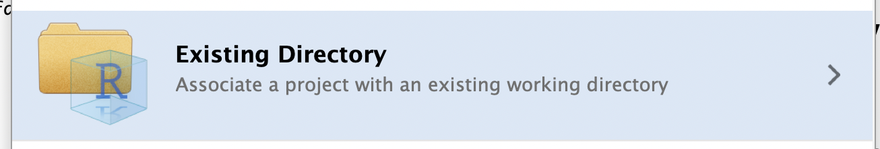
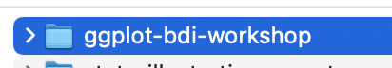
Rstudio & Rmarkdown
Right up corner

Slide 9
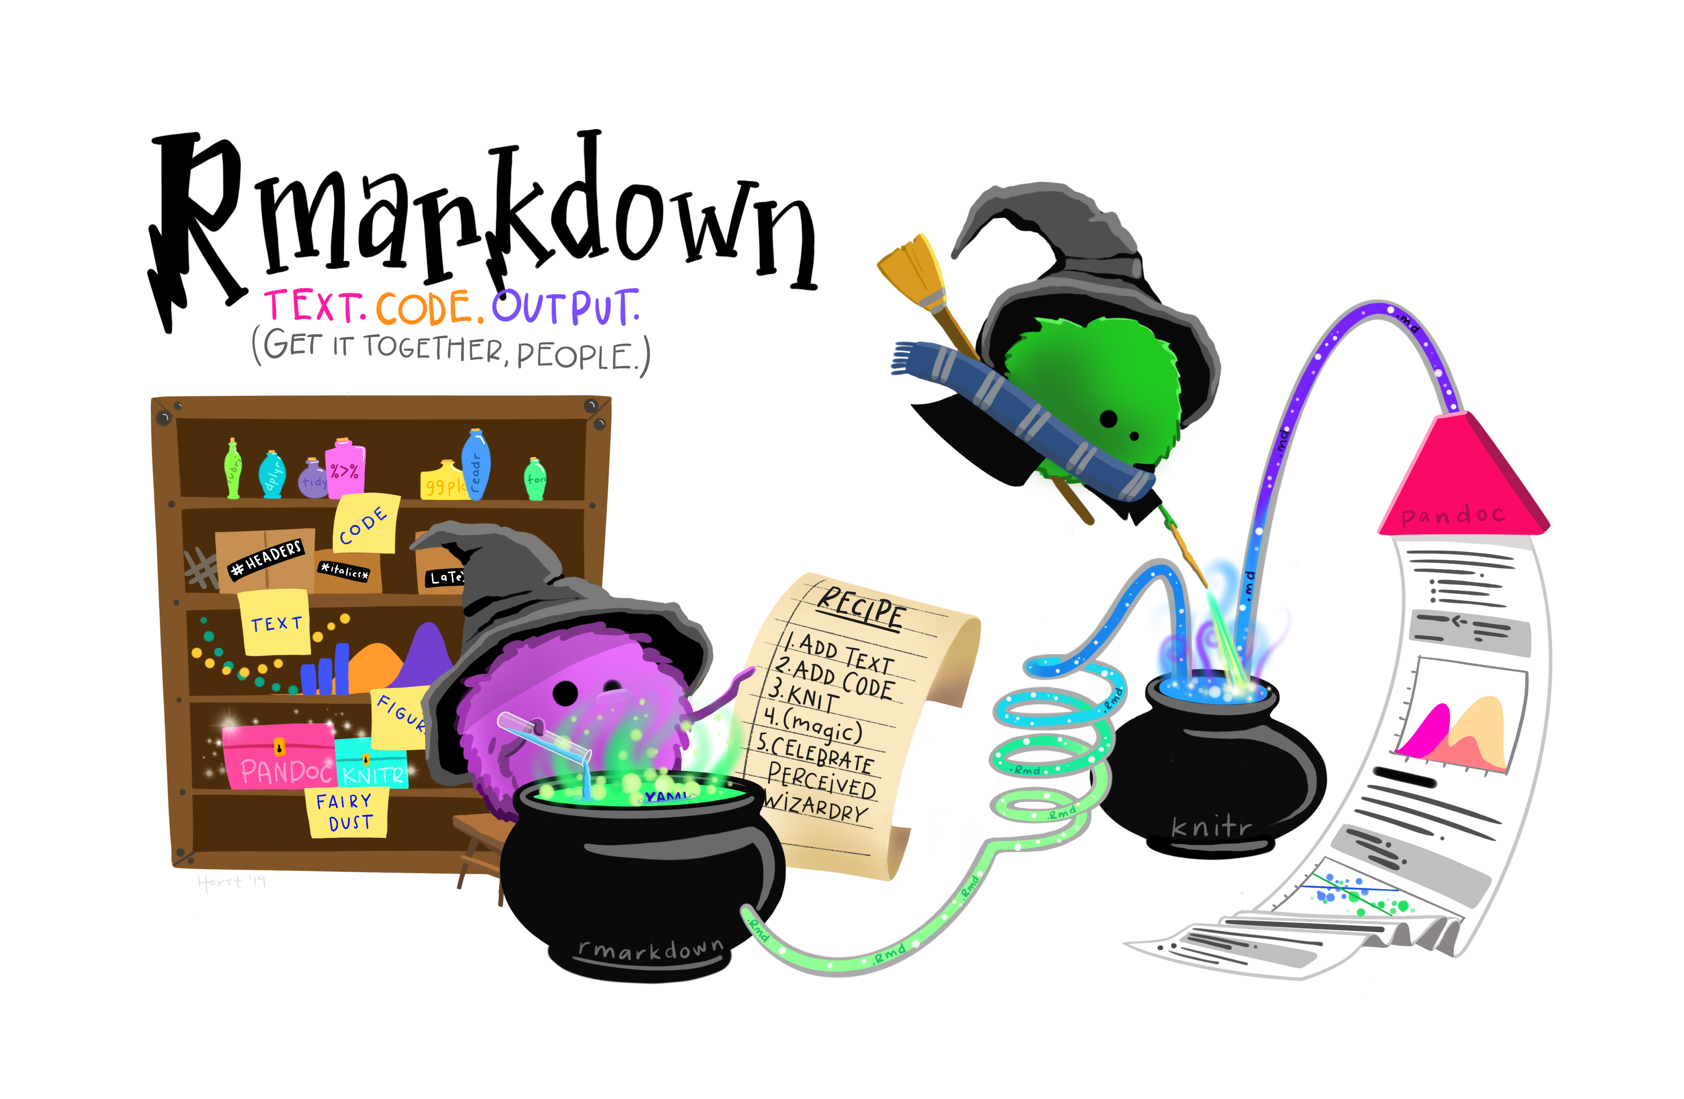
Rstudio & Rmarkdown
Plots inline
Easier to incorporate explanatory text
Can run one chunk at a time
Can create beautiful reports (but that’s another workshop material)
Artwork by @allison_horst

Slide 10
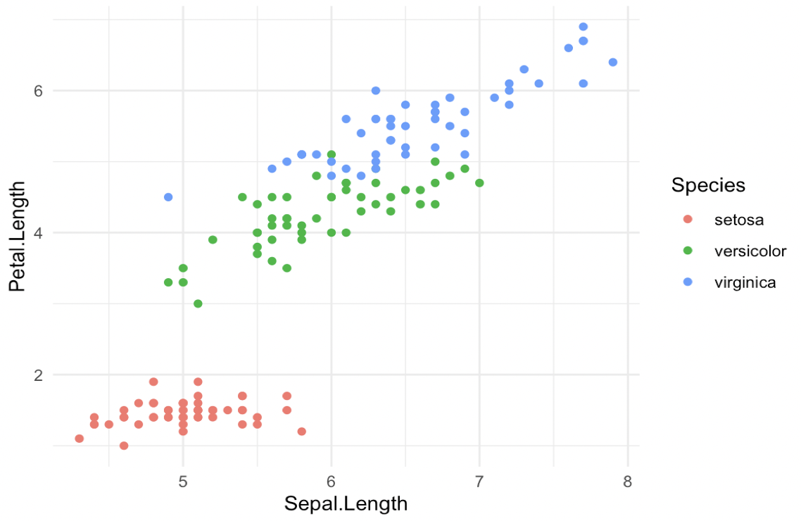
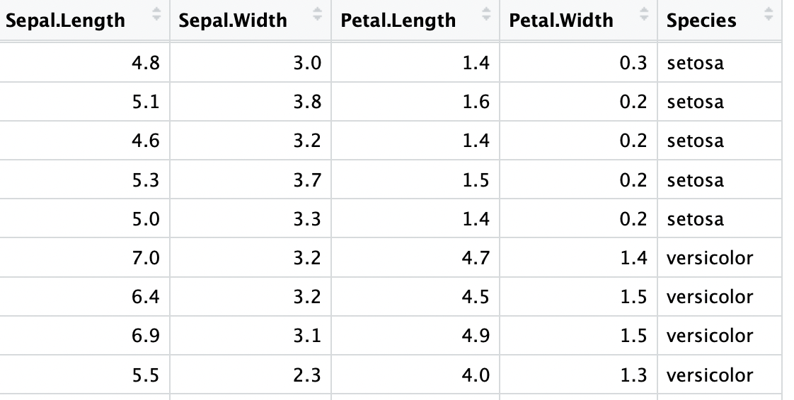
The basic elements of ggplot2 visualisations
plot
geom = plot type, shape
data
mapping
aesthetics = x & y axis, colour by group

Slide 11
practical part

Slide 12
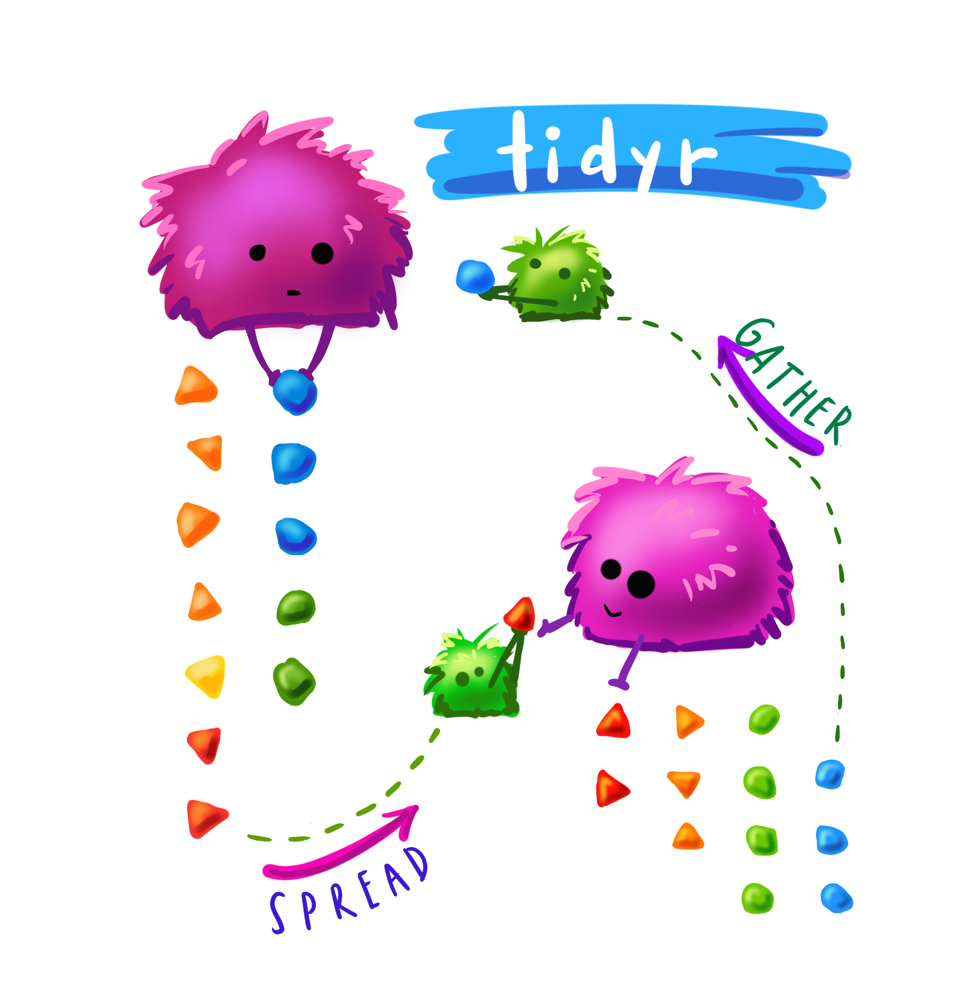
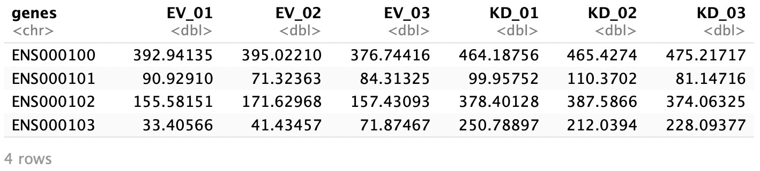
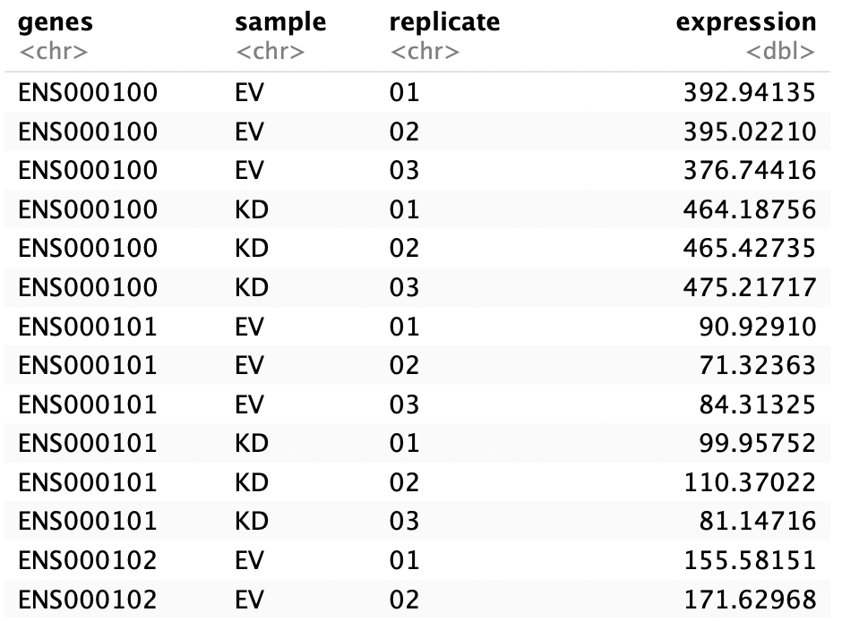
Long vs. wide data
Artwork by @allison_horst

Slide 13

Troubleshooting and resources
Artwork by @allison_horst

Slide 14
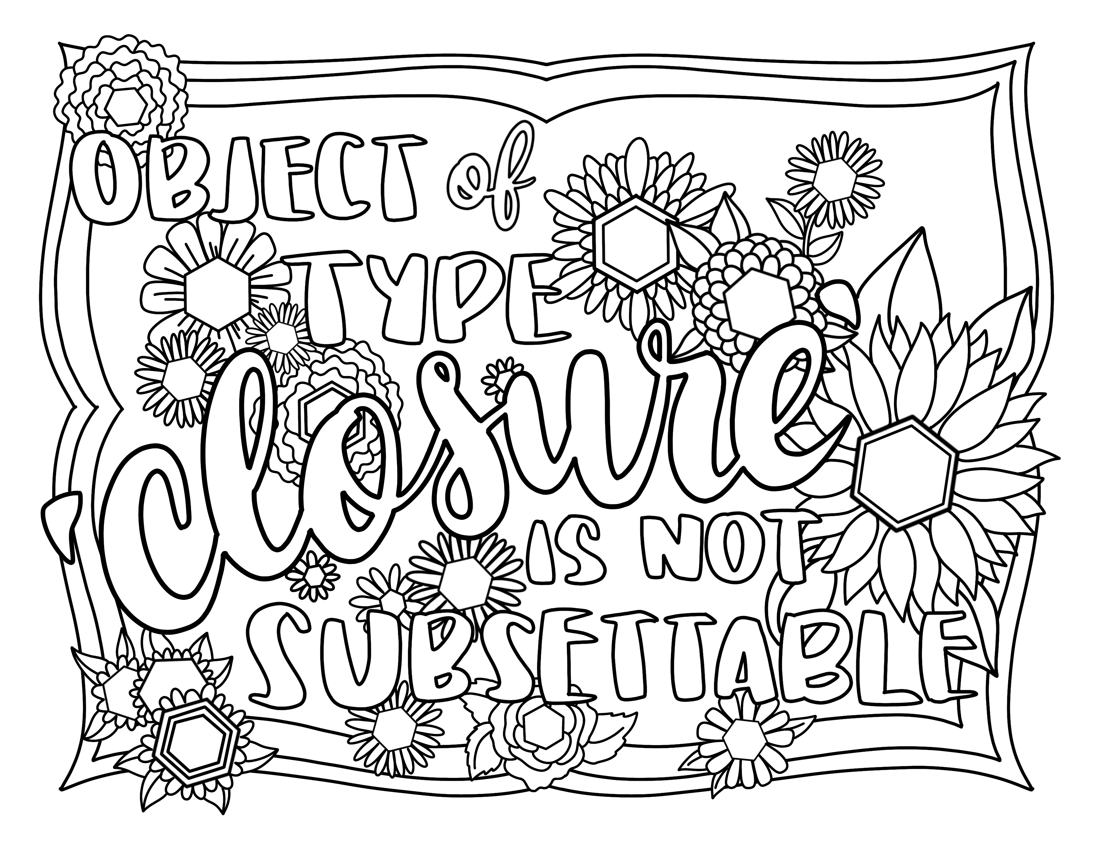
Error messages
`Roses are red,
violets are blue,
object of type closure
is not subsettable`
Some are famously unclear…
Artwork by @allison_horst

Slide 15
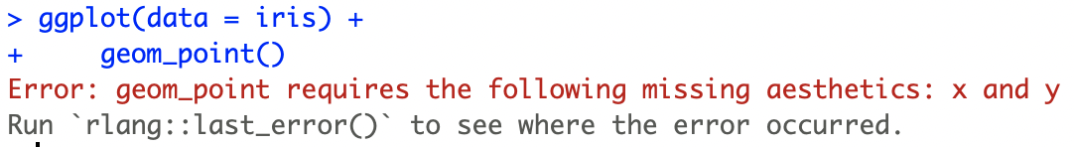
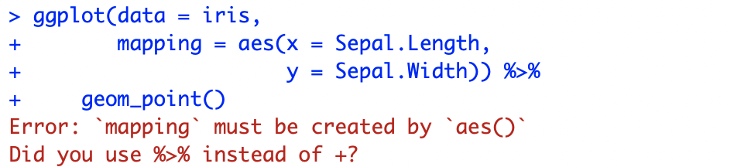
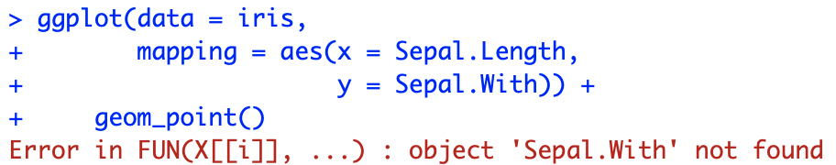
Error messages
…but the ones in ggplot2 tend to be great!

Slide 16


Looking for help
“Rotating x axis labels ggplot2”
“How to add horizontal line ggplot2”
“How to centre a title in ggplot2”
or paste a relevant part of an error message
There are way too many options for us to remember. No shame in googling things!

Slide 17

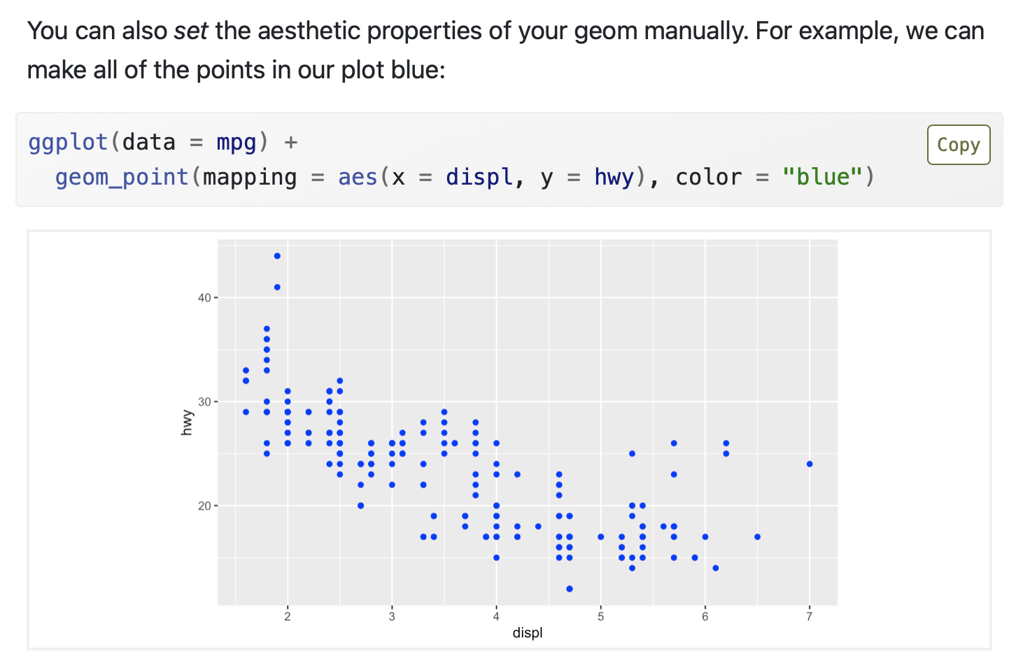
General R & ggplot2 resource
https://r4ds.had.co.nz
Amazing introduction to R through the Tidyverse. Includes a whole chapter about ggplot2.

Slide 18
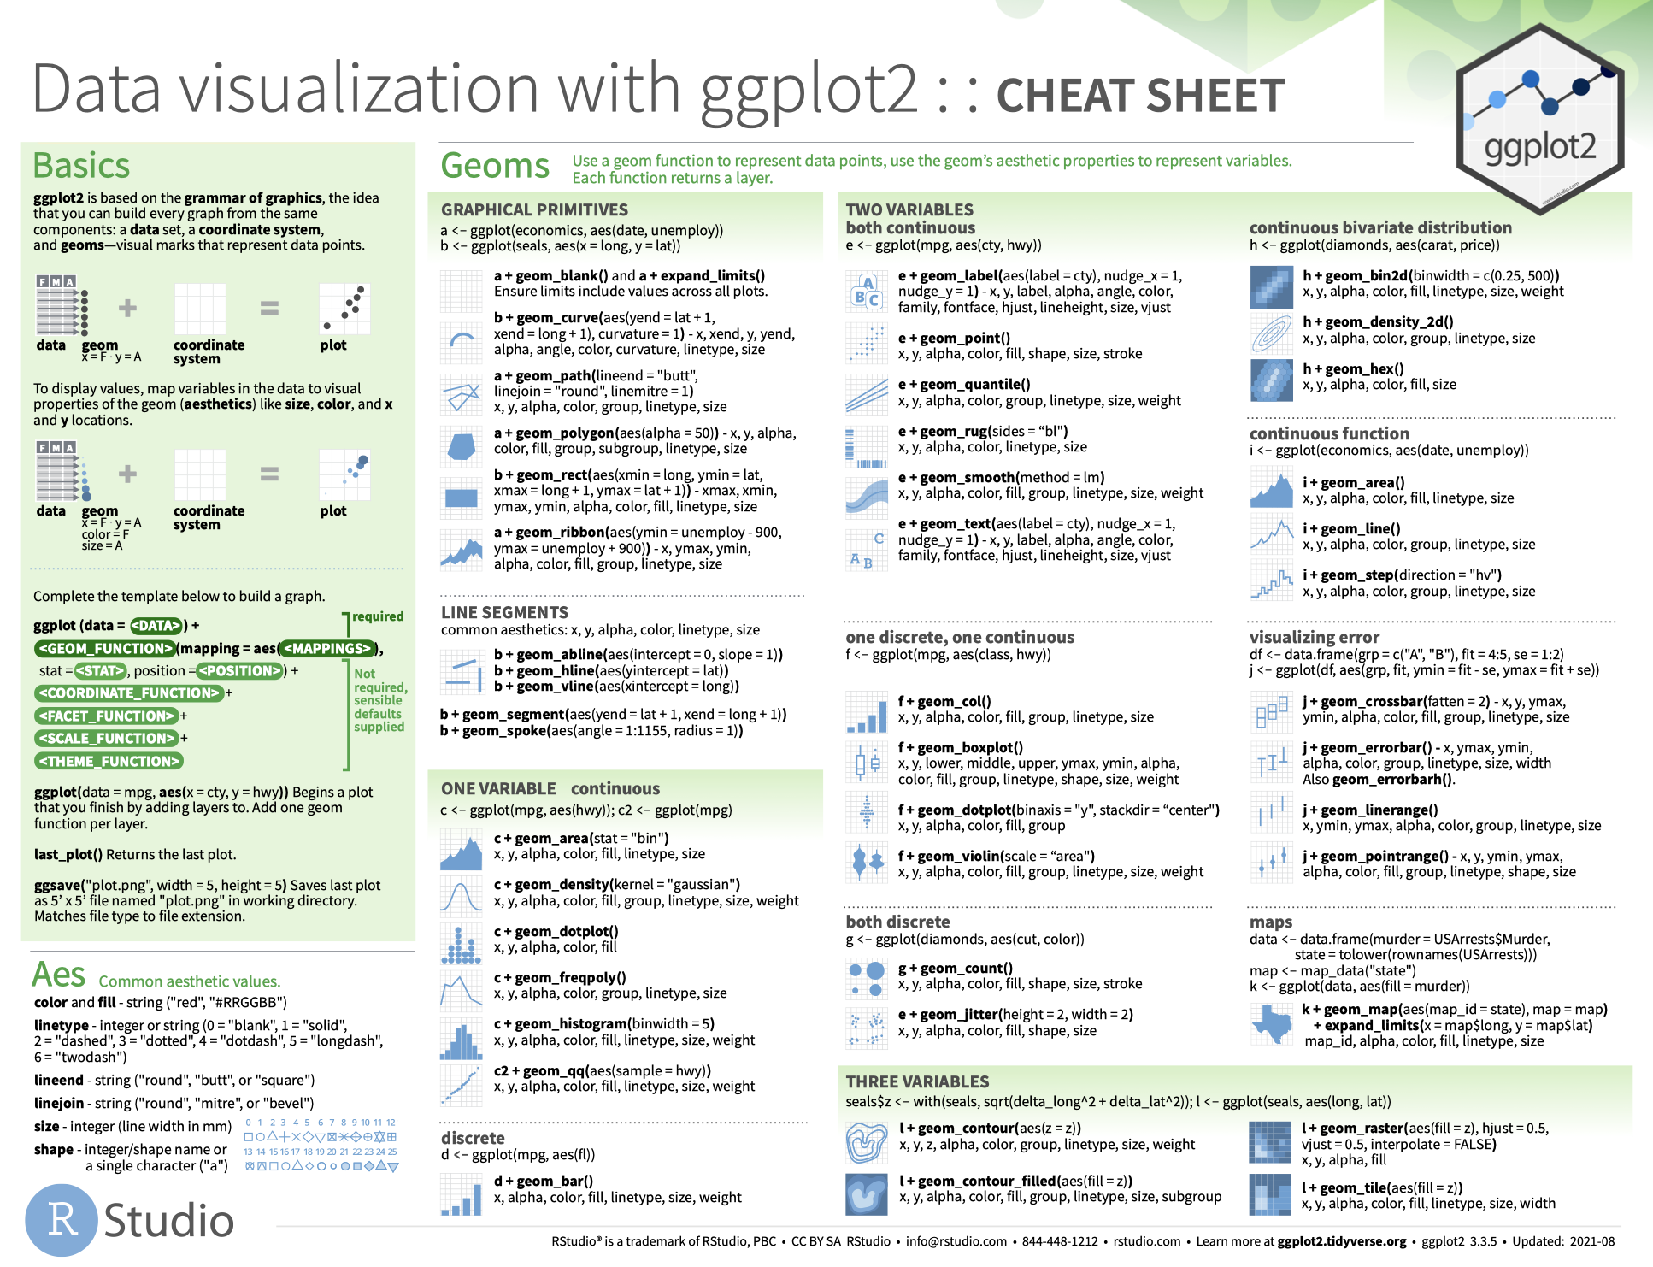
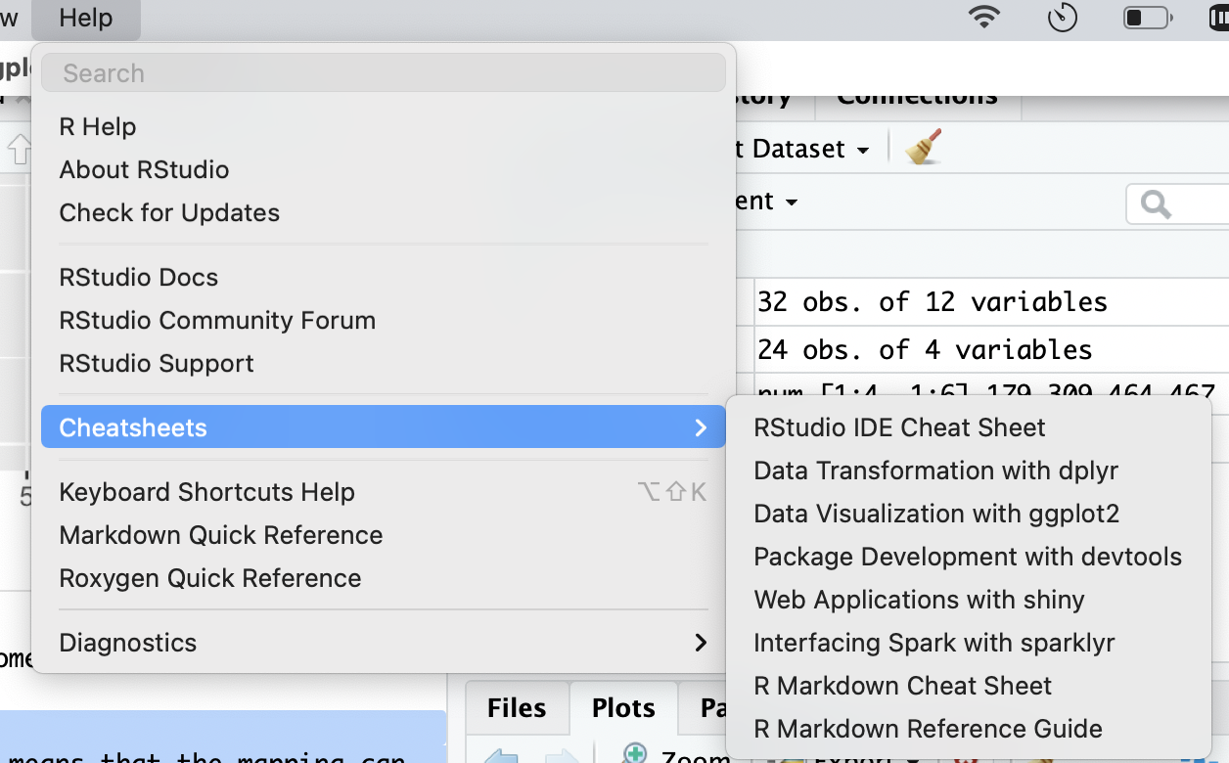
Cheatsheets – useful as a reference

Slide 19
Asking the right questions
99% of the time, someone has already asked the same question. The trick is to find it. If we really can’t find the answer, we can ask on Stack Overflow.
Some tips for getting a quick answer:
Include a reproducible chunk of data (or use the inbuild datasets),
Describe what happens is happening and what code you are currently using,
Show what you would like to achieve (if it’s not obvious)

Slide 20
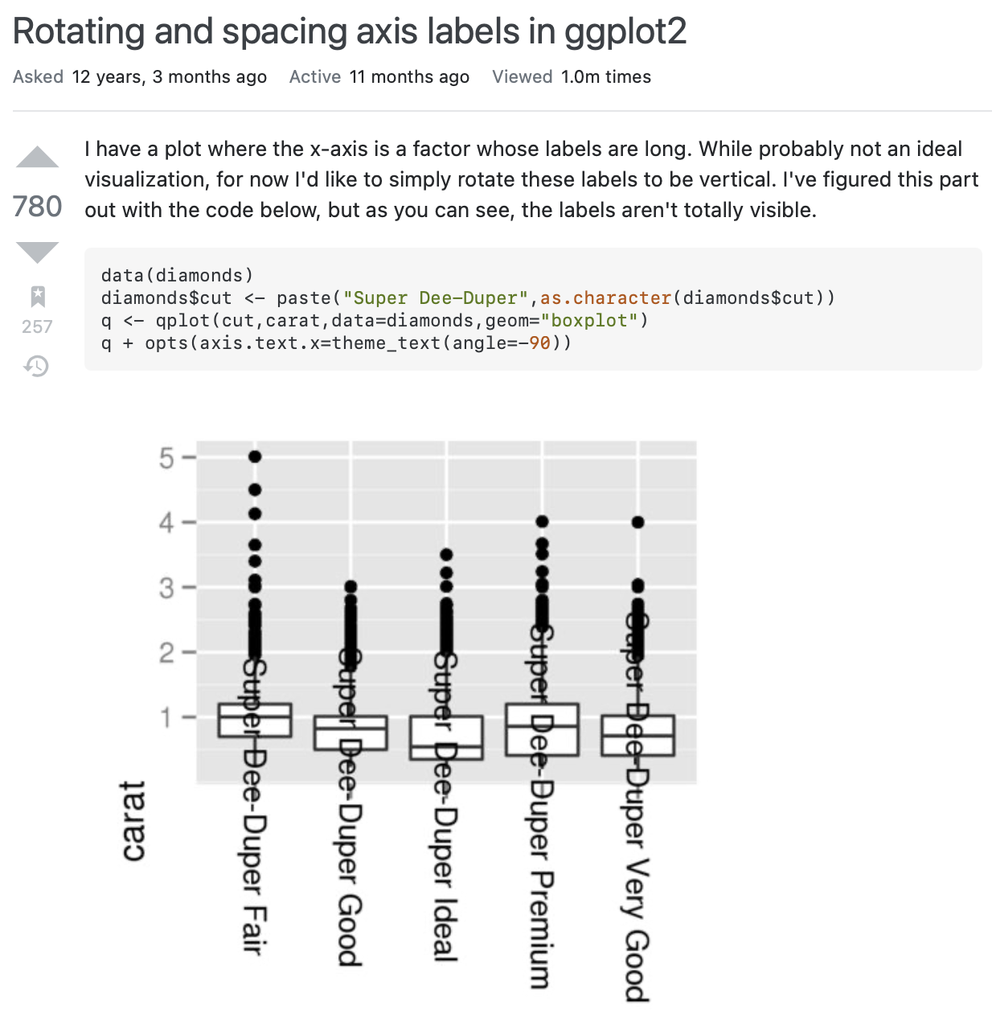
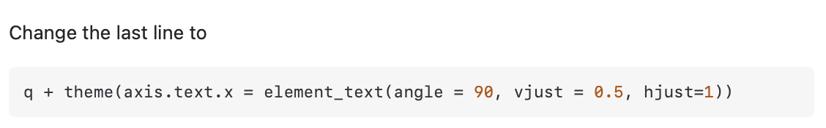
clear title
(look how many views!)
short description
showing the current code
using inbuilt dataset – easy to reproduce
obvious what needs to be corrected
Got an answer quickly!

Slide 21
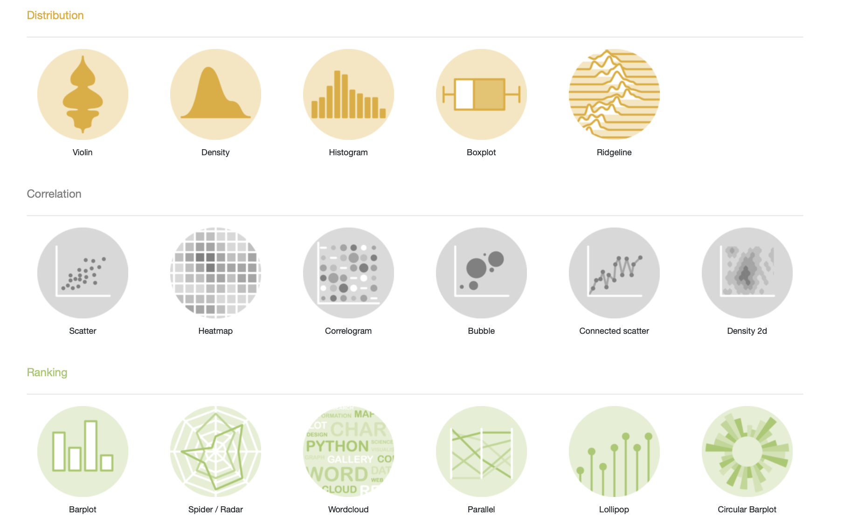
Chart ideas
The R Graph Gallery
https://www.r-graph-gallery.comx

Slide 22
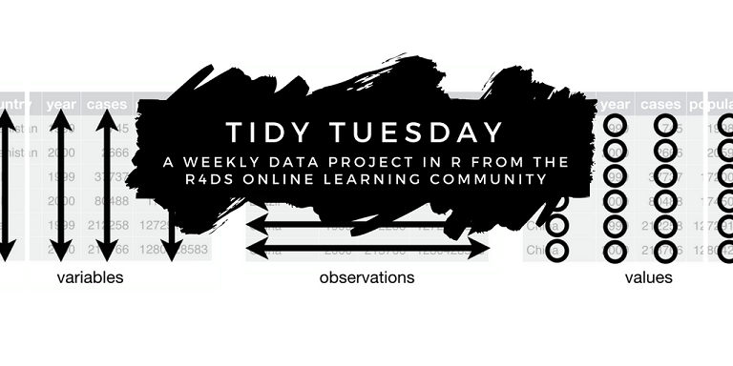
Chart ideas
Code attached to some publications (still quite rare)
TidyTuesday projects
https://github.com/rfordatascience/tidytuesday
https://github.com/gkaramanis/tidytuesday

Slide 23
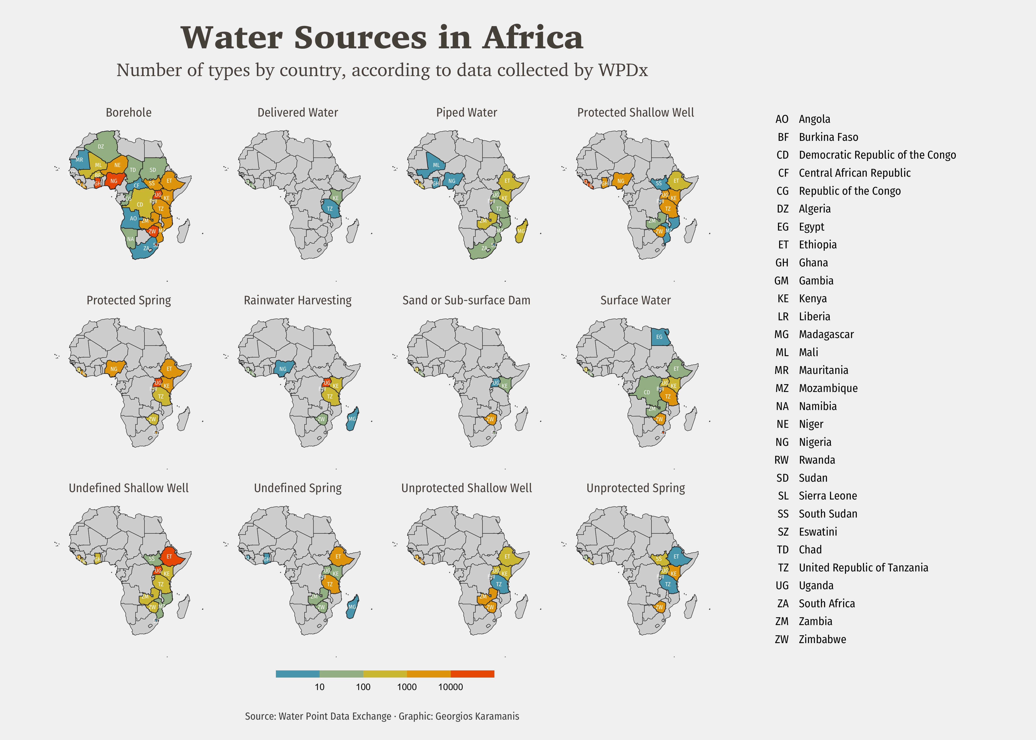
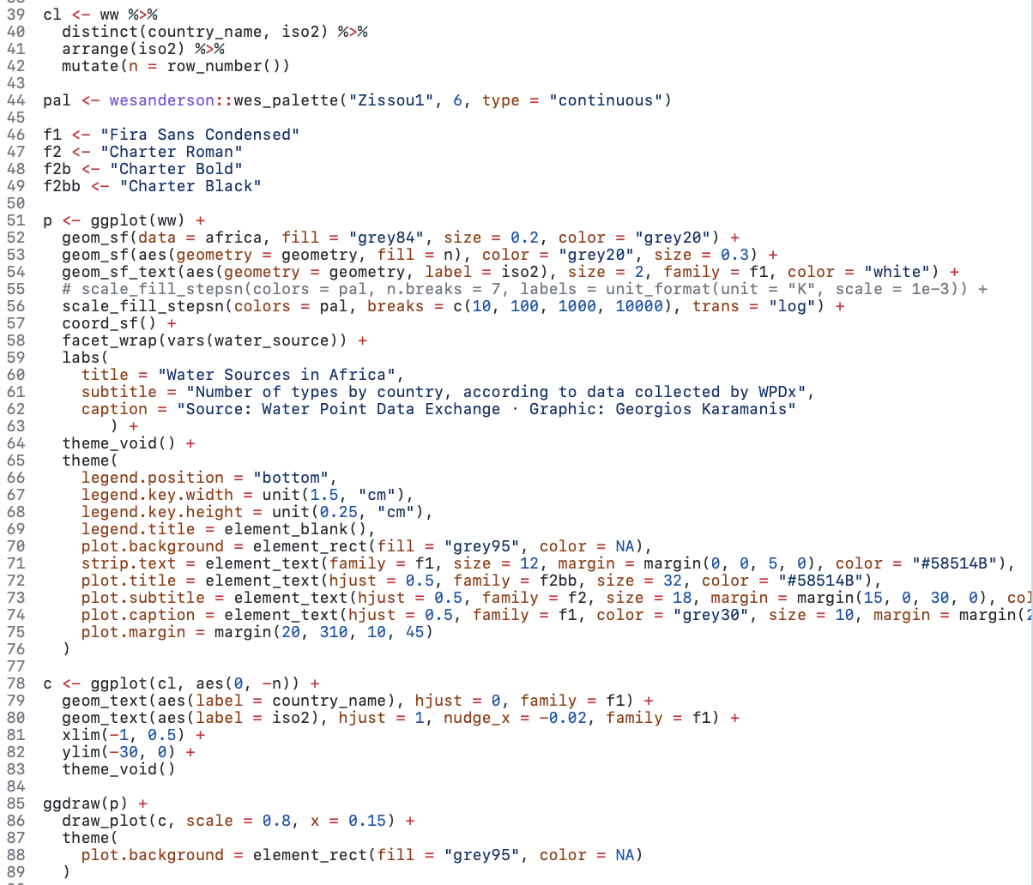
TidyTuesday examples
source: Georgios Karamanis

Slide 24
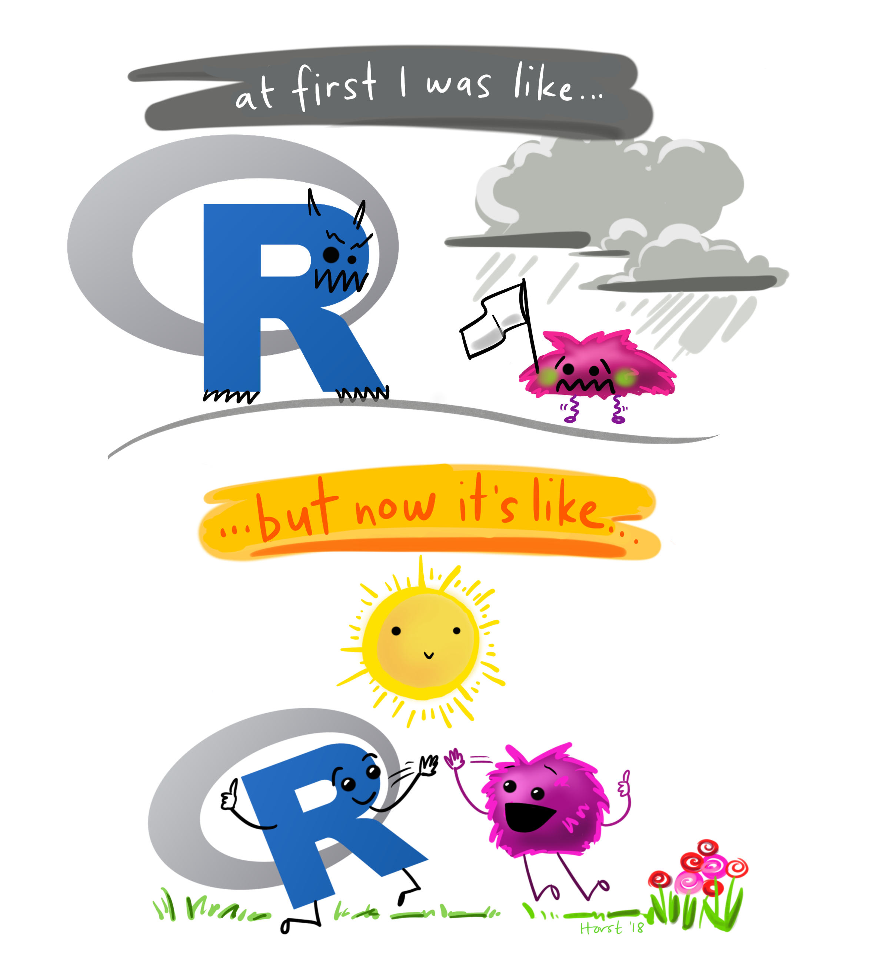
Thank you!
Artwork by @allison_horst

